Slide 1
ABC Phones installment credit portfolio
ANNEX TECHNOLOGIES · DATA ENGINEER CASE STUDY
Ryan Giggs
From raw files to a monitored pipeline and a dashboard, and what the data says about credit risk and customer satisfaction.
71,456
19,565
48
loan records across 5 quarterly snapshots
financed loans in the December 2025 snapshot
automated data quality checks on every run
Notes:
Open with the answer, then the route. This is a production-style build: raw CSVs and workbooks are cleaned and masked in Python, loaded to BigQuery, checked by 48 automated tests, modelled in SQL, and shown in a Looker Studio dashboard. The deck follows the brief in order: profiling and cleaning, features, pipeline design, data quality, portfolio health, credit versus customer satisfaction, and data gaps. All figures are from the December 2025 snapshot unless stated.

Slide 2
The raw files had seven problems, all handled and logged
PART 1A · PROFILING AND CLEANING
Problem found | Size | What we did
Loan Id is #N/A on most demographic rows | 76% of birth-date rows | Dropped, loan cannot be identified
Credit RETURN_DATE is corrupted | All 71,456 rows | Column dropped
Last payment date falls after the snapshot | 31.5%, 22,473 rows | Flagged, kept out of features
File named 30-03 holds 31 March data | 1 of 5 snapshots | Date read from the data
CUSTOMER_AGE is days since sale, not age | All rows | Age rebuilt from date of birth
Loan term not numeric, such as STDHIGH | 765 sales rows | Raw value kept and flagged
Same loan answered the NPS survey twice or more | 533 loans | Latest response flagged
No credit row was lost: 71,456 in, 71,456 out. Of the 20,742 loans in the latest snapshot, 11,175 have a valid age band, 10,609 have income and 3,532 have an NPS response.
Notes:
This is the profiling result from data_profiling.py and the cleaning log. The largest problem is that the demographic sheets carry #N/A in the Loan Id column on most rows (34,908 gender rows, 43,568 birth-date rows, 10,954 income rows), so those rows cannot be tied to a loan and are dropped. Nothing is imputed. Flags are added beside the source values and never overwrite them. The MAX_PAYMENT_DATE problem becomes the real anomaly in the quality framework on slide 6. Every step above is counted in outputs/cleaning_log.csv.

Slide 3

One pipeline from raw files to the dashboard
PART 1C · ETL DESIGN
Source files
Clean and mask
Staging
Quality gate
Features, marts
Dashboard
5 credit CSVs, sales and NPS workbooks. Never edited, archived in Cloud Storage.
BigQuery abc_staging, 5 masked tables.
48 checks before anything is built.
Looker Studio, 3 pages.
Python and pandas. Masking key from Secret Manager.
SQL builds abc_marts: 1 fact table, 3 metric tables.
Ingestion
If a critical check fails
Storage and access
Full reload on every run, safe at 71,456 rows. A daily check looks for new files. Identical files are skipped and a corrected snapshot replaces the old one.
The run stops and an ALERT is logged. The marts keep the last good data.
Fact table partitioned by snapshot date, clustered by loan. Analysts use Looker Studio or SQL on abc_marts.
Production option, not deployed: Cloud Scheduler starts a Cloud Run job that runs the same script. Full diagram: pipeline_design/architecture.png
Notes:
Seven steps run in order from scripts/run_pipeline.py: upload, clean, quality gate, features, marts, verify, analysis. Python handles the messy parsing; SQL handles features and metrics so analysts can read the logic. The masking key lives only in Secret Manager. The quality gate sits before the marts so bad data never reaches the dashboard, and the previous marts keep serving if a run is stopped. The simple stack is deliberate: three source files do not justify Airflow or dbt, and the growth path to both is documented in pipeline_design/architecture.md.

Slide 4
Four features, built as at each snapshot and masked at the door
PART 1B · FEATURES
Age band
Income band
Days past due
Risk category
age_band
avg_monthly_income_band
days_past_due
risk_category
Age on each snapshot date, from date of birth, which is then discarded. Bands 18-25, 26-35, 36-45, 46-55, 56+.
Amount received divided by Duration, a 1 to 24 month statement window. Eight bands, Below 5,000 to 150,000+.
Zero when arrears are not positive. The reported value is kept beside it for comparison.
Seven rules, first match wins. Critical: written off, returned or 61+ days late. High: first-payment default or 31-60 days. Medium: 8-30 days or earlier lateness. Low: current or paid off.
Masked at the door
Flag, never overwrite
Simple stack
Every ID is an HMAC-SHA256 hash. The key is in Secret Manager. A guard blocks any raw ID, email or phone number.
Quality flags sit in dq_ columns beside the source values. History features use earlier snapshots only.
Python for messy parsing, SQL for features. Airflow or dbt would be overkill for three source files.
Notes:
The age band is calculated at each snapshot, not once, so a customer moves between bands over time. The brief’s bands 46-55 and 55+ overlap; age 55 stays in 46-55, and under 18, over 120 or missing is Unknown. Income is Received divided by Duration because Duration is a statement window (mostly 6 or 12 months), and the brief’s literal sum is kept as avg_monthly_income_sum_all. The risk category is one CASE expression in sql/02_features/loan_snapshot_features.sql: seven rules, mapped to Not rated, Critical, High, Medium and Low. MAX_PAYMENT_DATE is excluded from features because it is stamped at extract time and leaks the future.

Slide 5
Every failure has a defined outcome, and re-running is safe
PART 1C · ERRORS AND RECOVERY
What goes wrong | What happens | How we know
A source file is missing | Cleaning stops with a clear message | ERROR log, failed step
A snapshot has not arrived | Gate stops the run, last good marts keep serving | ALERT line, dq_results
A file cannot be parsed | Crash before any write, retried twice, then stop | ERROR log, failed step
A critical check fails | Run stops and is not retried | Exit code 2, ALERT line
Personal data would reach a table | Write refused, marts scanned again | ERROR log, exit code
A cloud call fails | Step retried, no double load | Warning per attempt
The pipeline runs twice | Nothing changes, identical files are skipped | load_audit checksums
Why a retry is safe
Loads replace whole tables, so a retry cannot double-load. The marts are rebuilt only after the quality gate passes, so the dashboard never reads half-built data.
Notes:
Retries apply only to crashes, such as a network or quota error. A critical data quality failure is never retried, because retrying cannot fix bad data. The five staging tables load as separate jobs, so a failure between them can leave some tables new and others old; the run then reports a failure, the marts are not rebuilt, and the next run repairs it because every load replaces the whole table. Step outcomes are recorded in logs/pipeline_runs.csv.

Slide 6
48 automated checks caught a real source defect
PART 2 · DATA QUALITY FRAMEWORK
Check family | Count | Catches
Freshness | 4 | Missing or shrinking snapshots
Uniqueness | 5 | Duplicate loans and responses
Referential integrity | 7 | Orphan loans across tables
Null thresholds | 13 | Missing keys, dates, amounts
Range | 7 | Impossible values and dates
Schema contract | 5 | Column or type changes
Personal data scan | 7 | Raw IDs, emails, phones
REAL ANOMALY, RUN OF 5 OCT 2026
31% of rows have a last payment date after the snapshot date
The extract stamps this field when it is exported, so older snapshots contain future information. It is flagged and kept out of features and machine learning.
WARNING [warning] range.payment_date_after_snapshot_share: observed 0.3145 vs threshold 0
43 checks: 42 passed, 1 failed (0 critical)
scripts/quality_checks.py · sql/04_dq_checks/
Log from the first full run, before the 5 schema checks were added.
Alerting. Critical: engineer at once, business owner next morning, engineering lead if still open after 4 hours. Warning: email and weekly digest. Info: recorded.
Cadence. Real time, on every load: files, row counts, keys, personal data. Daily: all 48 checks. Weekly: trend and drift review.
Notes:
The framework has seven check families, 48 checks in all: 36 in SQL, 5 schema-contract checks that compare INFORMATION_SCHEMA with the contracts in sql/01_staging, and 7 personal-data scans. Results go to abc_staging.dq_results and outputs/dq_results.csv. Critical failures exit with code 2 and stop the run before the marts are built. The anomaly is real: 31.45% of rows carry a MAX_PAYMENT_DATE later than the snapshot date. Because it was caught as a warning rather than a critical failure, the load continues, and the column is excluded from features and ML. The log lines on the slide are verbatim from run 48e9868e; the 48-check run adds the schema checks.

Slide 7
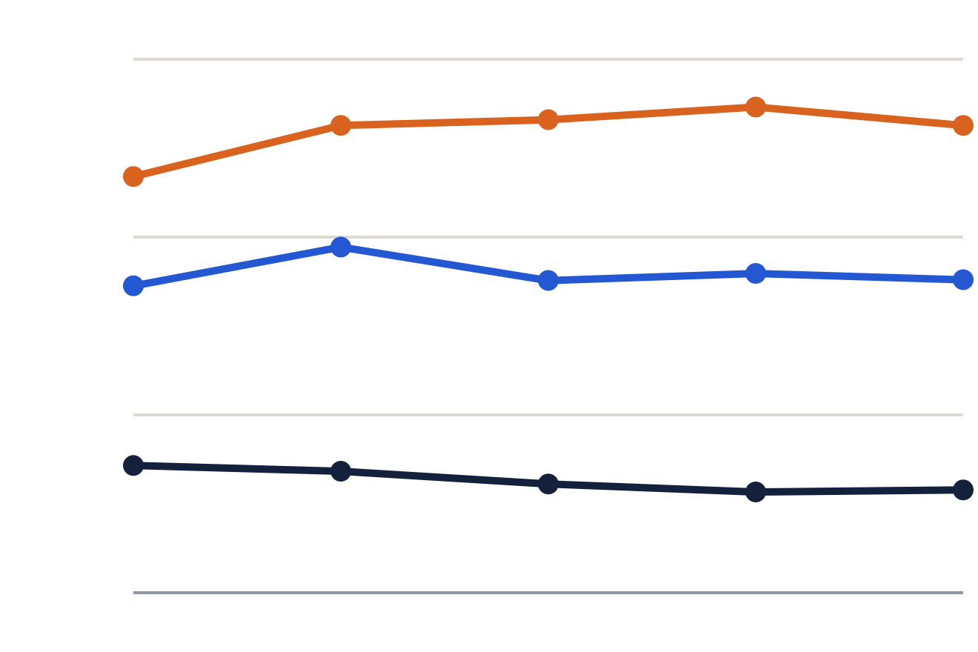
Delinquency is steady, loss stays high, first-payment default is improving
PART 3A · PORTFOLIO HEALTH, FIVE SNAPSHOTS OF 2025
Risk rates at each snapshot (lower is better)
Money collected
30%
94.2%
Loss 26.3%
94.6% in Jan, low 93.1% in Jun. Recovering.
20%
Behind on payments 17.6%
Higher is better
10%
Customers retained
First payment missed 5.8%
95.8%
0%
93.6% in Mar, 95.8% now. Improving.
Jan
Mar
Jun
Sep
Dec
Higher is better
Snapshots: 1 Jan, 31 Mar, 30 Jun, 30 Sep, 30 Dec 2025. Delinquency and collection use performing loans. Loss is lost loans over all financed loans. Retention starts in March because it compares each snapshot with the one before.
Notes:
Five key metrics: delinquency (8-90 days past due), loss, first payment default, collection and retention. The dashboard adds a sixth, seriously late (31-90 days), at 11.3% in December, as a drill-down of delinquency. Read-outs: delinquency 17.3, 19.4, 17.6, 18.0, 17.6 percent; loss 23.4, 26.3, 26.6, 27.3, 26.3; first payment default 7.2, 6.8, 6.1, 5.7, 5.8; collection 94.6, 93.5, 93.1, 93.6, 94.2; retention 93.6, 94.3, 95.4, 95.8 from March. Definitions: a loan is live if it is financed and not Paid Off or Returned. A loan counts as lost when it is live and written off or 91+ days past due, and the loss rate divides lost loans by all financed loans. Performing is live and not lost. Collection is total paid over total due today on performing loans. Retention is the share of loans that were Active, Inactive or PAR 7 at the previous snapshot and are neither returned nor lost now. Why the lines move: newer cohorts start healthier, and new losses fell from 9.1% to 5.5% of the prior book per quarter. The axis starts at zero on purpose, so the lines show how little delinquency moved. The full explanation per line is in outputs/charts_explained.md and on dashboard page 1.

Slide 8
Customers on lower incomes fall behind more often
PART 3A · WHO FALLS BEHIND
Behind on payments, by monthly income (average 17.3%)
Behind on payments, by age
Below 5,000
24.7%
18-25
20.2%
5,000-9,999
21.0%
26-35
16.9%
10,000-19,999
19.5%
36-45
15.5%
20,000-29,999
19.5%
46-55
15.7%
30,000-49,999
17.9%
56+
20.6%
50,000-99,999
16.6%
Income shows the clearer pattern. The youngest and oldest groups also fall behind more than ages 26 to 55.
100,000-149,999
12.9%
150,000+
15.0%
The segment that stands out: income below 5,000 at 24.7% against an average of 17.3%. Loans sold since 1 Jan 2025, December 2025 snapshot. Delinquency falls steadily as income rises (trend test p < 0.0001). Below 5,000 has only 170 performing loans and 56+ only 73, so those two bars are the least certain.
Notes:
Segments use only loans sold since 1 January 2025, because age and income exist only for loans sold from late 2024: income coverage is about 0% for sales before 2024Q4 and 85-88% for 2025 sales. Rates are ratios of sums, so small groups are not over-weighted. Below 5,000 at 24.7% against a 17.3% average is the most striking single gap, but after correcting for 13 segments compared (Bonferroni) it is not significant on its own (adjusted p about 0.13); the trend across income bands is, with a Cochran-Armitage test p below 0.0001. Orange bars mark the highest group in each chart. This is the same data as dashboard page 2.

Slide 9
Customers who fall behind score us lower
PART 3B · CREDIT AND CUSTOMER SATISFACTION
Average score (0 to 10), by how late
Average score, by experience
Up to date
6.8
Trouble getting customer care help
Late 1-30 days
6.1
Yes
4.4
Late 31-90 days
5.7
No
7.7
Late 91+ days
4.3
Phone lock experienced
There is no credit score in the data, so days late stands in for it. NPS: +6.5 up to date, -39 at 91+ days late.
Yes
5.7
No
7.1
Payment delay experienced
Yes
5.8
No
7.1
RECOMMENDATION
Contact customers in the first 7 days of arrears, make customer care easy to reach, and offer a simple payment plan. Test it against a control group.
Collections and satisfaction are in tension: customers who experienced a phone lock score 5.7 against 7.1. Trouble getting help rises from 32% when up to date to 45% at 1-7 days late.
Notes:
Each customer counts once, at their latest survey response, on financed loans only. NPS is the share scoring 9-10 minus the share scoring 0-6, with a bootstrap confidence interval. The pattern is consistent: the further behind a customer is, the lower the score, and customers who struggled to reach customer care score about 3 points lower (NPS -47 against +28). That is the lever the recommendation targets: contact in days 1-7, before a missed payment becomes a long arrears case. Caveats: this is an association, not proof of cause, and among late customers those reporting difficulty were not more likely to end up Critical (n=114, inconclusive), which is why the recommendation is a test against a control group, not a rollout.

Slide 10
What the data lacks, and what to improve first
PART 3C · DATA GAPS AND NEXT STEPS
What is missing
What is inconsistent or unclear
Three improvements
A working Loan Id on the demographic sheets
A customer id, so one person’s loans cannot be linked
Employment type and location
Payment-level history
Write-off date and amount
A credit score
Mixed date formats and #N/A tokens
Last payment date stamped at extract time
Write Off means 91+ days past due
PAR 30 mostly holds write-offs
What Duration means (a statement window)
Loan terms such as STDHIGH
Stable keys. One customer id and one loan id, in every file.
History with dates. Status and payments with effective dates.
A data contract. Validate each file at the source before delivery.
NEXT: MACHINE LEARNING
Predict which loans reach 91+ days or Critical by the next snapshot, using features as at each snapshot only and a split by time. With only 4 snapshot transitions, results will be indicative.
Notes:
The biggest gap is identity: with a working Loan Id in the demographic sheets and a customer id, coverage of age and income would rise well above the current 50% and people with several loans could be linked. Payment-level history and write-off dates would replace the proxies used today, such as treating 91+ days past due as loss. The three improvements are ordered by effect: stable keys first, then dated history, then a data contract so the defects profiled on slide 2 are caught at the source instead of in the pipeline. The machine learning phase is not built yet: the target is a loan reaching 91+ days or Critical at the next snapshot, MAX_PAYMENT_DATE stays excluded, and the split is by time because the data is a panel of snapshots.

